Slide 1
North East Sessional GP (NESG) retention Survey
September 2015
Paula Wright
Ijay Omagh

Slide 2
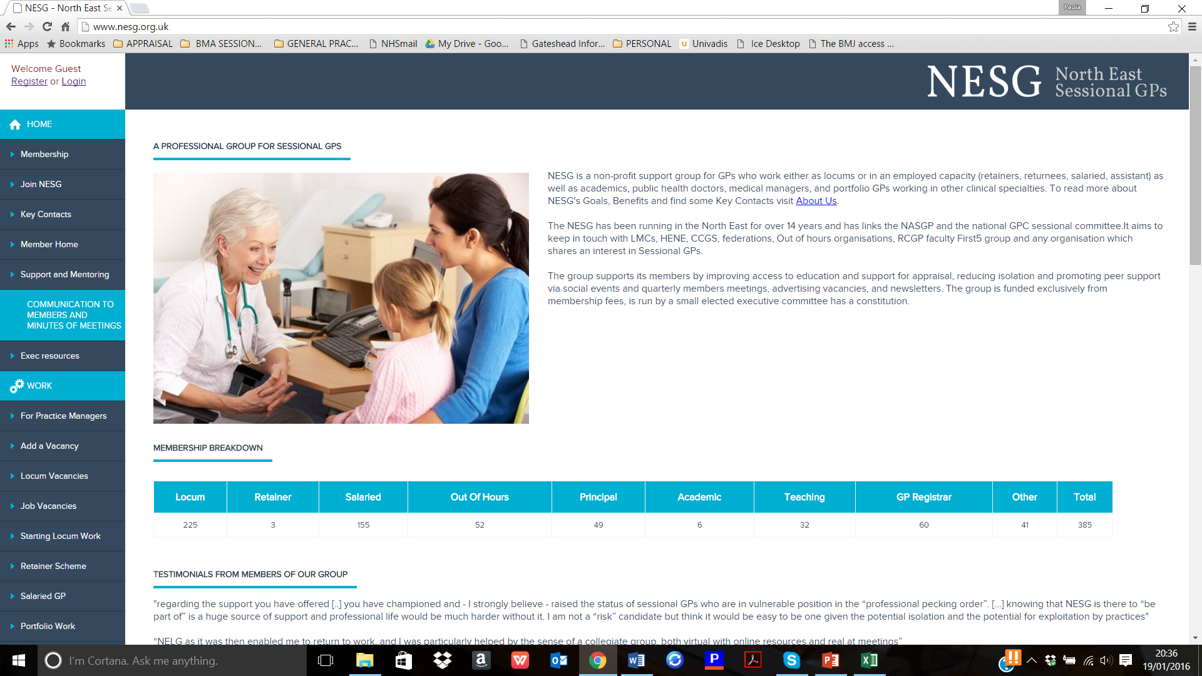

Slide 3
What does NESG do?
Cascade vacancies (free to practices)
Cascade educational events
Provide education
Newsletters
Peer support-members meetings
Social event
Help forming learning groups

Slide 4
Why the survey?
Recruitment/ 10 point NHS plan: returners/retainers –what about sessionals ?
Sustainability of continuing to run a group of 385 by volunteers
Loss of HENE funded education programme after 10 years (now delivered by NESG volunteers)

Slide 6
Areas covered
Type of work and hours
Past and future intentions of leaving GP
Why ?
Has NESG helped ?
What would be ideal ?
How much more would you work ?
Access to education

Slide 7
Response rate 40%
151 out of 378 responded
Locums 63
Salaried 63
Reg 2
Partner 22

Slide 8
Do you feel you have been at risk of leaving GP clinical practice in the last 3 years ?
4 =high risk
3=some risk
2-low risk
1=no risk

Slide 9
Do you feel you have been at risk of leaving GP clinical practice in the last 3 years ?
4 =high risk
3=some risk
2-low risk
1=no risk

Slide 10
Are you considering leaving GP clinical practice in the next 3 years?
4 | Definitely,
3 | Probably
2 | Unlikely -
1 | very unlikely

Slide 11
Are you considering leaving GP clinical practice in the next 3 years?

Slide 12
Why leaving ?
Stress from GP work
Intensity of GP work
Length of GP day
Partners
Salaried
Locums
Isolation/ needs for a better work life balance/ Not being paid for the hours I work
Stress of Appraisal and Revalidation
Not being paid for the hours I work
needs for a better work life balance
Complaints and Litigation
Loss of Confidence
, Stress of Appraisal and Revalidation
Not being paid for the hours I work/ isolation/ Complaints and Litigation

Slide 13
What would be your ideal working arrangements - feel free to dream!

Slide 14
Ideal working conditions- workload/hours
More time with patients
less intense workload
Shorter days
Less admin/better efficiency
Flexibility round school holidays
Protected time for letters/labs/ scripts

Slide 15
Ideal working conditions
Stop revalidation,
redress against vexatious complainers,
reduce indemnity fees.

Slide 16
Ideal conditions ? Quotes
a recognition by the rest of NHS that GP are not refuse collectors
More acceptable work load whilst being able to maintain patient safety.
Able to work as part of a team, where I can feel valued despite my need to work differently.

Slide 17
Ideal conditions ? Quotes
… the help keeping up with the breadth of knowledge required to feel competent

Slide 18
Ideal conditions ? Quotes
Not being treated like a criminal all the time with so many checks for me to prove my innocence. Not being undermined by the NHS, Government and the Media as incompetent, overpaid etc. Not having to go through the sham of appraisal and revalidation as a 'support for doctors development' when it is a thinly disguised policing system.

Slide 19
If you were to get your ideal working conditions how many extra hours a week would you be willing to work ?

Slide 20
How many hours of daytime GP work do you do a week?

Slide 21
If you were to ‘get’ your ideal working hours, how many more hours of clinical work per week would you be willing to do ?

Slide 22
Has NESG helped reduce your risk of leaving general practice or reduced your risk of having a significant break from practice?

Slide 23
Has NESG helped reduce your risk of leaving general practice or reduced your risk of having a significant break from practice?

Slide 24
Have you had any difficulties obtaining information about local educational events?
Locums 37% several times 33% sometimes
Salaried 8% several times 13% sometimes
Partner 0 several times 5% sometimes

Slide 25
Access to education
Have you been turned away from events because you are a locum ? 20%

Slide 26
Do you receive information about education
from the CCG?
Locum22% partner 27% salaried 29%
From the federation ?
0%
Tutor ?
Locums 8% salaried 5%
Trust
Registrars 33%

Slide 27
About getting information about educational events ?
I've tried to get info on local timetables for learning events in the area where I live and hit a wall.
Not ever contacted by anyone other than NESG regarding teaching. Only received via the practice at my request
I don't feel that they [CCG] support learning for locum GPs. I also receive info from University because I do some teaching for them. It is NESG that provides the best info about learning events.
I don't receive any and it is difficult to access essentials such as CPR and Child protection training - a CCG wanted to charge me for essential child protection modules.
Almost all information seems to be from NESG

Slide 28
Other comments
Enjoying locum work may make me stay in clinical practice longer.
Sessional work gives you back your life, trust me 27 yrs. of practice is long enough

Slide 29
Comments
Becoming an independent locum was a new start. I wouldn't have continued working otherwise.

Slide 30
Conclusions
Causes for considering leaving are similar
Untapped source in sessionals -not just train/retrain new GPs.
They are an “at risk pool” - Peer support/education reduces loss
Education seen as NESG role (previous delivered via HENE role) but not sustainable without proper support
NESG provides recruitment/advertising service to practice for free and effective

